Slide 1
Microeconomics
Competition

Slide 2
Markets: Features & Characteristics
(a) Buyers and Sellers – Price transparency
(b) Area-- APMC
(c) Commodity – Perishable goods/Durable Goods/ non-durable
(d) Different forms of Competition
(e) Money transaction
Group of Firms--Industry

Slide 3
Market Forms: Classification
Number of Firms
Firm =1 (Monopoly)
Firm = 2 (Duopoly)
Big players “Price decrease followed immediately” ,
“Price increase takes time” –PRICE RIGIDITY
Firms more than 3
(b) Ease of Entry and Exit of the Firms “huge Invt”
Firms vs Industry
(c) Degree of Product Differentiation

Slide 4
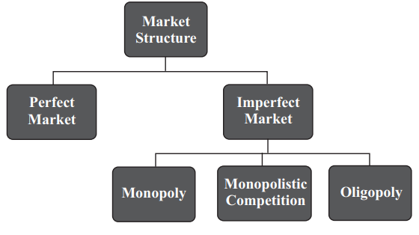
Basic Market Forms:
1 Seller Many Buyers Monopoly
Many Buyers & Many Sellers & product differentiation monopolistic FMCG
Few large Players Oligopoly - Telecom, PVR-INOX, Airlines

Slide 5
Perfect Competition: Features
1. Very Large number of buyers and sellers
2. Homogeneous Product Milk-Petrol-Salt
3. Firm is a Price Taker- Industry decides the price
4. Free Entry and Exit
5. Perfect Knowledge
6. Perfect Mobility
7. No Selling Costs

Slide 6
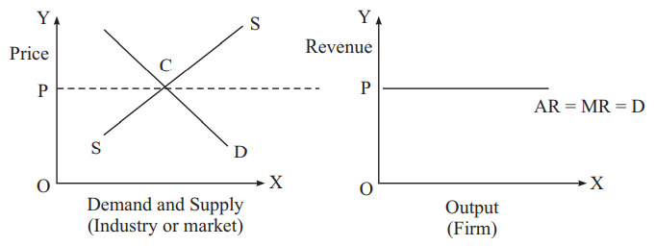
Firms Vs Industry
Demand curve for the firm is horizontal and perfectly elastic. It means that the firm can sell any amount of the product at the price determined by the industry, but the firm cannot vary the price.

Slide 7
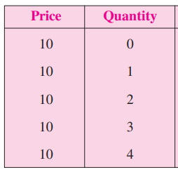
Revenue of the Firm
TR = Price*Qty
Calculate TR, AR and MR.
The Selling price of the Product is Rs. 10
AR = TR/Q MR= TRn – TRn-1

Slide 8
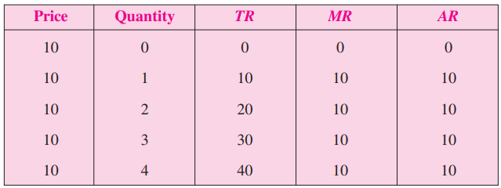
Calculation of AR & MR
TR = Price*Quantity
AR = TR/Q
MR = TRn – TRn-1

Slide 9
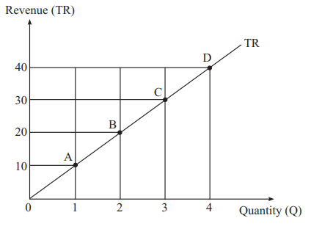
Graph of Total Revenue
* If Q= 0, TR =0
X- Axis: Quantity, Y axis: TR
Observation: With increase in Quantity, the TR Increases.

Slide 10
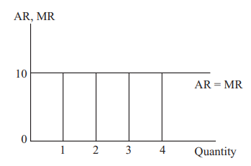
Graph of AR & MR
In Perfect Competition, The revenue graph is AR

Slide 11
Concept of Profits
Profit is defined as the difference of total revenue (TR) over total cost (TC) of the firm.
Profit = TR – TC.
Economists often distinguish between super normal profit and normal profit.
Super normal profit is defined as the surplus of total revenue over total cost. This means total revenue is greater that total cost.
TR>TC, Super Profit
TR=TC, TR-TC= 0, Normal Profit
TR<TC, Loss

Slide 12
Super Profits Vs Normal Profits
If super normal profit exists at each unit of the output or at each quantity of the output then we must compare revenue and cost at each quantity.
You know that revenue per unit of the good is called average revenue (AR).
Similarly, cost per unit of the good is called average cost (AC).
If AR – AC is positive or AR > AC then there will be super profit.

Slide 13
Normal Profits
When total revenue equals total cost, the difference between them becomes zero.
Normal profit means TR – TC = 0 or TR = TC.
This also means that AR or P equals AC if we divide quantity. i.e. TR=TC or AR = AC
Loss: When the firm’s total cost exceeds total revenue ,
i.e. TC > TR the firm incurs loss.

Slide 14
Monopoly: characteristics
1. Single Seller
2. No Close Substitute
3. No to Entry
4. Price Maker
5. Price Discrimination

Slide 15
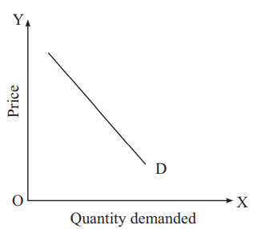
Shape of Demand Curve
A monopolist has full control over the price, therefore, he can sell more by lowering the price. This makes the demand curve downward sloping. As there is no competition of the firm in the market, demand curve is in elastic.

Slide 16
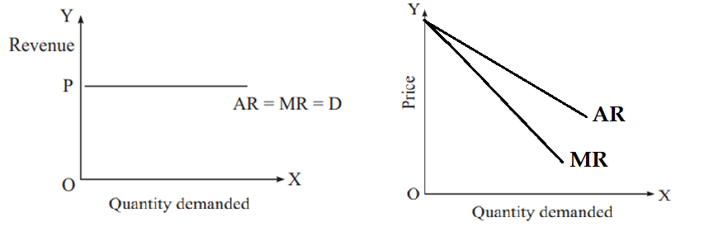
Perfect Competition Vs Monopoly
Revenue Curves

Slide 17
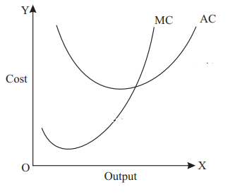
Cost Curves
AC and MC : AC is Cup shaped Curve, MR is a Nike symbol

Slide 18
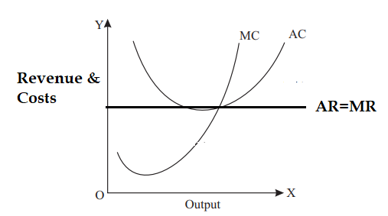
Interaction of Revenue & Costs
Perfect competition: Revenue curve is a straight line, Costs AC & MC just cuts the AR-MR Line.

Slide 19
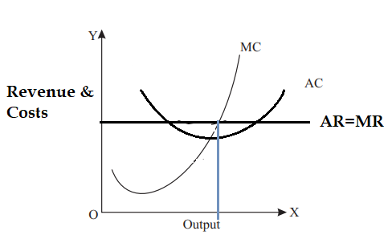
Graph observation:

Slide 20
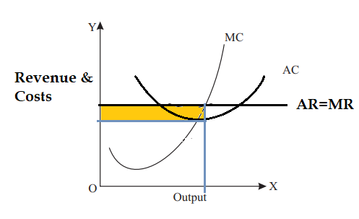
Shaded Area
No possibility of Shaded area in Perfect Competition
There is no Super profit. “ A firm in Perfect competition can earn only Normal Profit”

Slide 21
Quiz:
The average cost of a firm is 10. It sold 10 units at a price of 10. What type of profit did the firm earn?
Normal profit=> P=AC
2. If TR > TC, then there is normal profit.
True of false
3. If TR = TC, then there is super normal profit.
True or false.
4. If AR < AC, then there is loss.
True or false

Slide 22
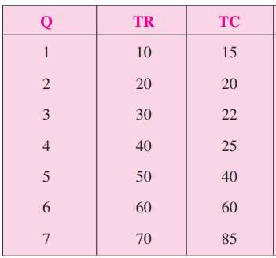
PROFIT MAXIMIZATION OF A COMPETITIVE FIRM
TR and TC approach
2 Approach to
Profit Maximization
TR-TC Approach
MR-MC Approach
Profit = Total Revenue – Total Cost
Demand Curve is given by the AR

Slide 23
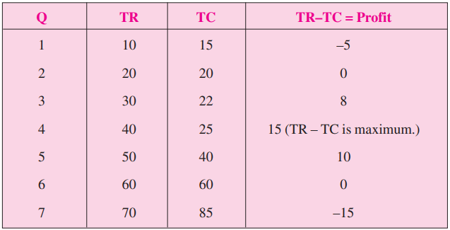
Derivation of Profits using TR-TC Approach
Graph: Quantity on X axis, TR and TC on Y axis.

Slide 24
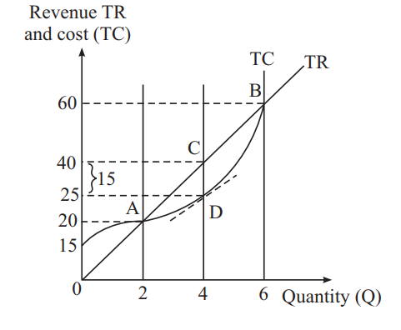
Loss & Profit in the TR-TC Approach
CD= Max profit and the condition for Normal Profit
Point A & Point B = Zero

Slide 25
MR-MC Approach
Calculate MR & MC

Slide 26
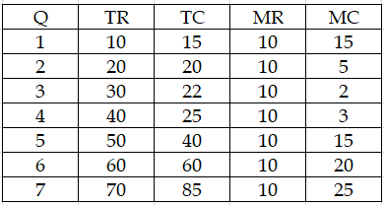
MR & MC
X axis- Quantity
Y -Axis- MR & MC

Slide 27
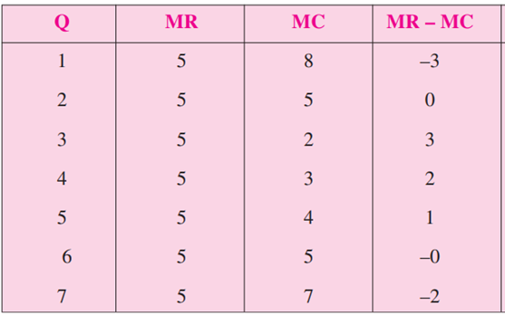
MR-MC Approach- Perfect Competition
The profit of a firm will be maximum at
> level of output which MC is equal to MR.
> MR=MC
> MR-MC=0

Slide 28
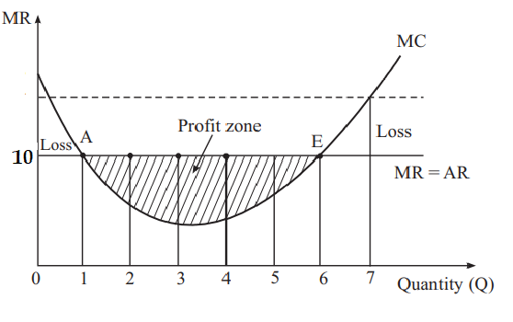
Necessary condition for Profit Maximization
First order condition. The Firm’s MC must be equal to its MR at the equilibrium level of Output.
Second order or condition. At the equilibrium level of Output, the MC curve should have positive slope or MC curve intersects MR curve from below.

